Slide 1

USA Data Job Analysis using Python

Slide 2
🔍 Project Purpose
This analysis was inspired by my curiosity to better understand the evolving job landscape for data analysts. By leveraging real-world data and Python tools, I’ve answered key questions that matter most to anyone navigating this career path, such as:
Which skills are most in demand for the top 3 data-related roles?
How are the most requested skills trending over time?
What is the relationship between skill demand and salary?
Which skills are both high-paying and frequently requested?

Slide 3
🛠️ Tools & Technologies Used
To conduct this analysis, I utilized the following tools and technologies:
Python — the core programming language for data processing and visualization.
Pandas — used for data cleaning, transformation, and exploration.
Matplotlib — for basic charting and visualizations.
Seaborn — to build more sophisticated and visually appealing plots.
Jupyter Notebook — to combine live code with visual output and markdown commentary.
Visual Studio Code — my preferred IDE for running and testing Python scripts.
Git & GitHub — for version control, collaboration, and showcasing the final project.

Slide 4

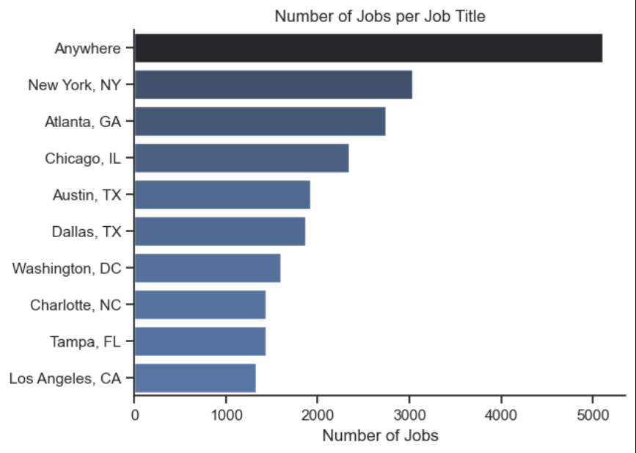
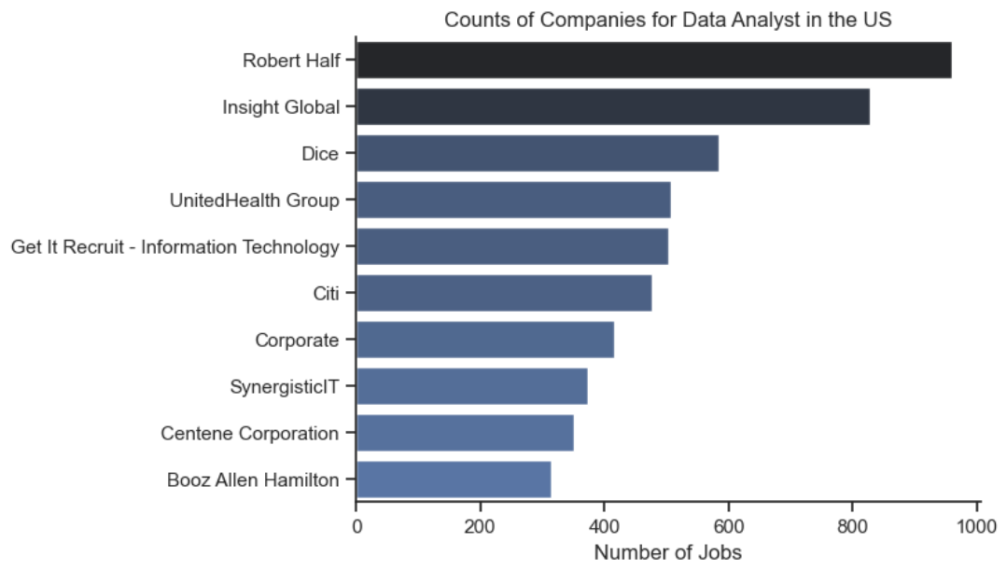
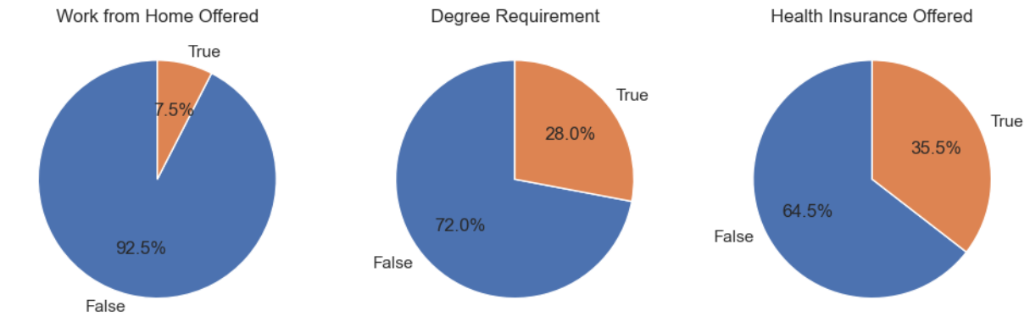
Exploratory Data Analysis

Slide 5
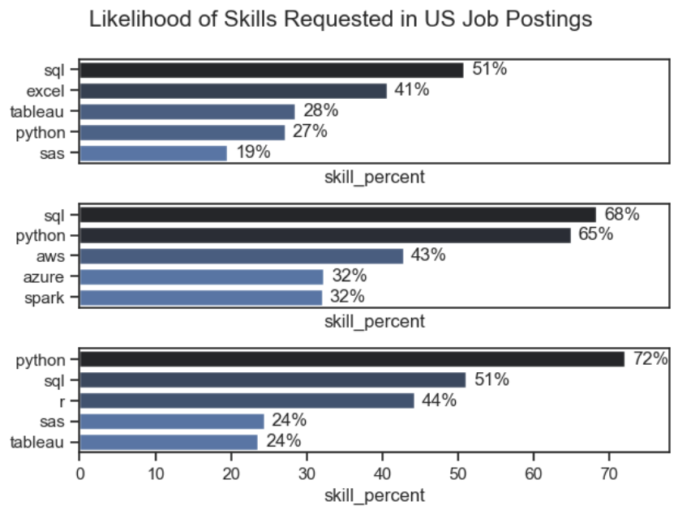
Skills Requirement

Slide 6
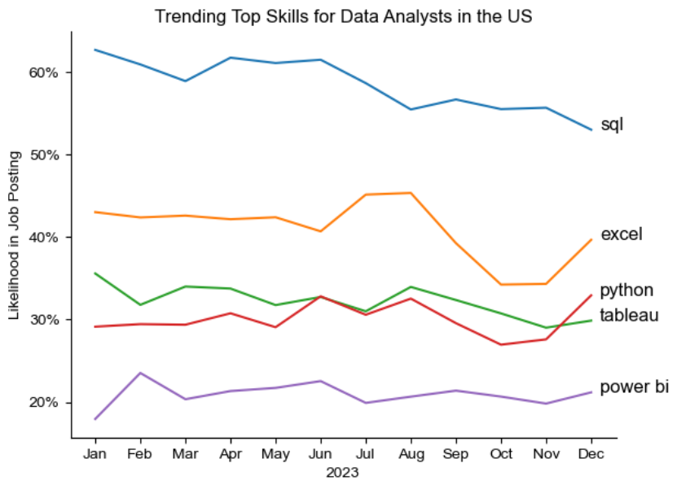
Data Analysts Top Skills Trend

Slide 7
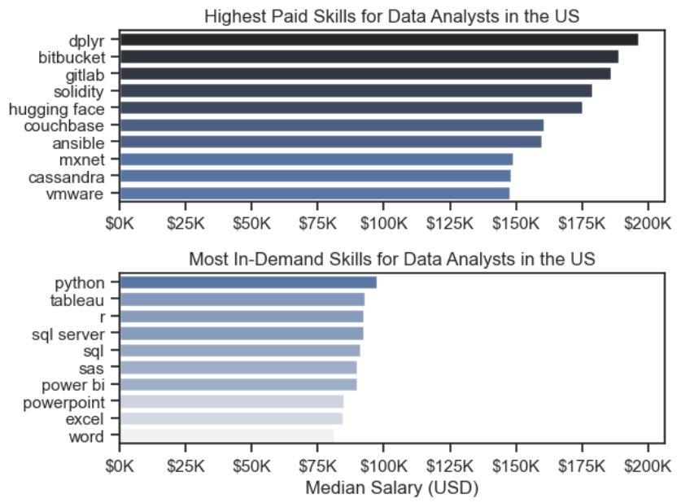
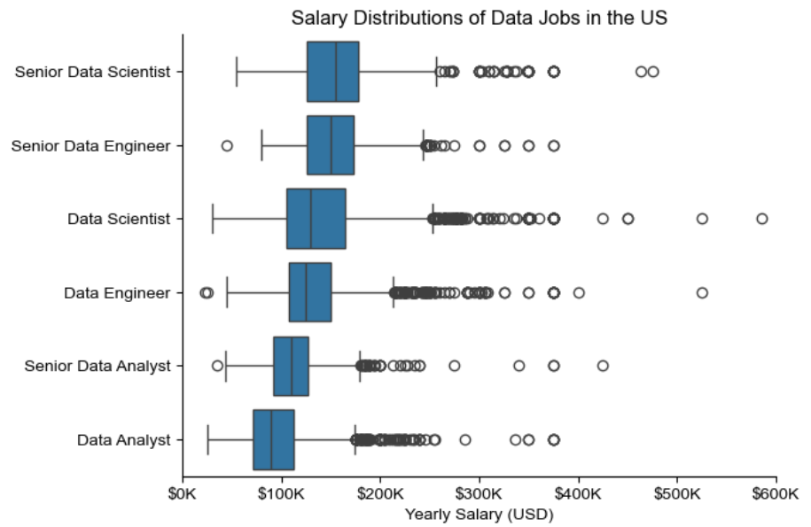
Salary Analysis

Slide 8
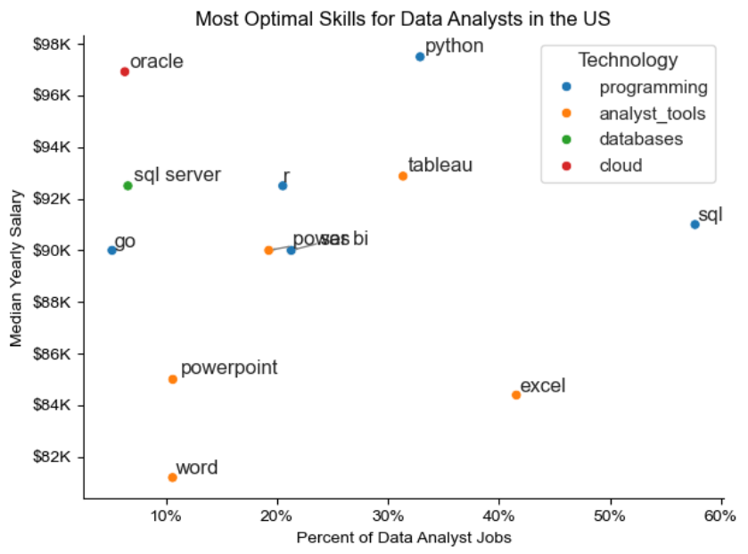
Optimal Skills

Slide 9

Thank you
By Tanvir Taushif

